Slide 1
Calculo Numérico I Sistemas de Ecuaciones Lineales
Dr. Luis Sanchez

Slide 2
Objectives:
Knowing how to solve small sets of linear equations with the graphical method and Cramer’s rule.
Understanding how to implement forward elimination and back substitution as in Gauss elimination.
Understanding the concepts of singularity and ill-condition.

Slide 3
Systems of Linear Equations

Slide 4
Review of Matrices
2nd row
Elements are indicated by a _{i j}
row
column
m^{th} column
Row vector: Column vector:
Square matrix:
- [A]_{nxm} is a square matrix if n=m.
- A system of n equations with n unknonws has a square coefficient matrix.

Slide 5

Special Types of Square Matrices
Symmetric
Diagonal
Identity
$$[A]=\left[\begin{aligned}a_{11} a_{12}⋯ a_{1n} \\ a_{22}⋯ a_{2n} \\ ⋱ ⋮ \\ a_{nn}\end{aligned}\right]$$
Upper Triangular
Lower Triangular

Slide 6
Review of Matrices
Augmented matrix: is a special way of showing two matrices together.
For example augmented with the
column vector is
Determinant of a matrix:
A single number. Determinant of [A] is shown as |A|.

Slide 7
Methods to solve Systems of Linear Equations
Graphical Method.
Cramer’s Rule.
Method of Elimination.
Gauss Elimination.
Gauss-Jordan Elimination.
For n ≤ 3

Slide 8
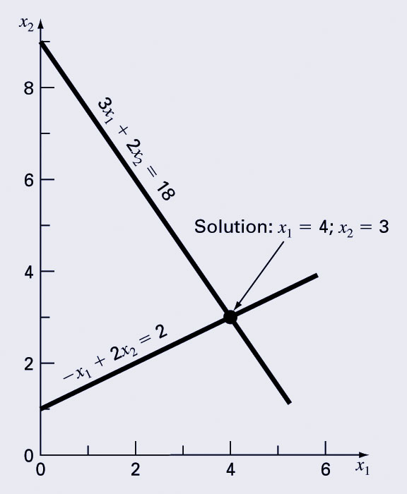
1. Graphical Method
For small sets of simultaneous equations, graphing them and determining the location of the intercept provides a solution.
Solve:
Plot x₂ vs. x₁, the intersection of the lines presents the solution.
For n = 3, each equation will be a plane on a 3D coordinate system. Solution is the point where these planes intersect.
For n > 3, graphical solution is not practical.

Slide 9
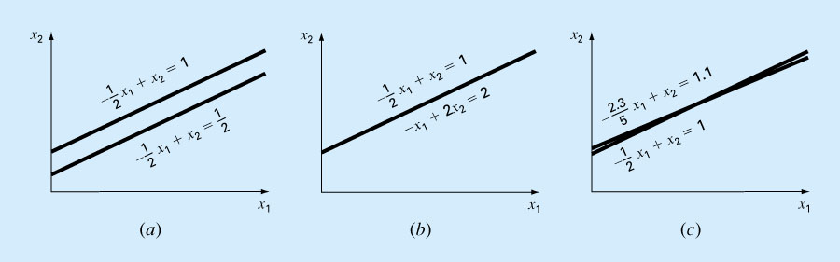
1. Graphical Method (cont)
Graphing the equations can also show systems where:
No solution exists
Infinite solutions exist
System is ill-conditioned (Mal Condicionado)
(sensitive to round-off errors)

Slide 10
1. Graphical Method
Mathematically
Coefficient matrices of (a) & (b) are singular. There is no unique solution for these systems. Determinants of the coefficient matrices are zero and these matrices can not be inverted.
Coefficient matrix of (c) is almost singular. Its inverse is difficult to take. This system has a unique solution, which is not easy to determine numerically because of its extreme sensitivity to round-off errors.

Slide 11
2. Cramer’s Rule
For a set of three equations:
Where [A] is the coefficient matrix:
Cramer’s Rule states that each unknown in a system of linear algebraic equations may be expressed as a fraction of two determinants with denominator D and with the numerator obtained from D by replacing the column of coefficients of the unknown in question by the constants b₁, b₂, …, b_{n}.

Slide 12
2. Cramer’s Rule

Slide 13
Cramer’s Rule Example
Find x₂ in the following system of equations:
Find the determinant D
Find determinant D₂ by replacing D’s second column with b
Divide

Slide 14
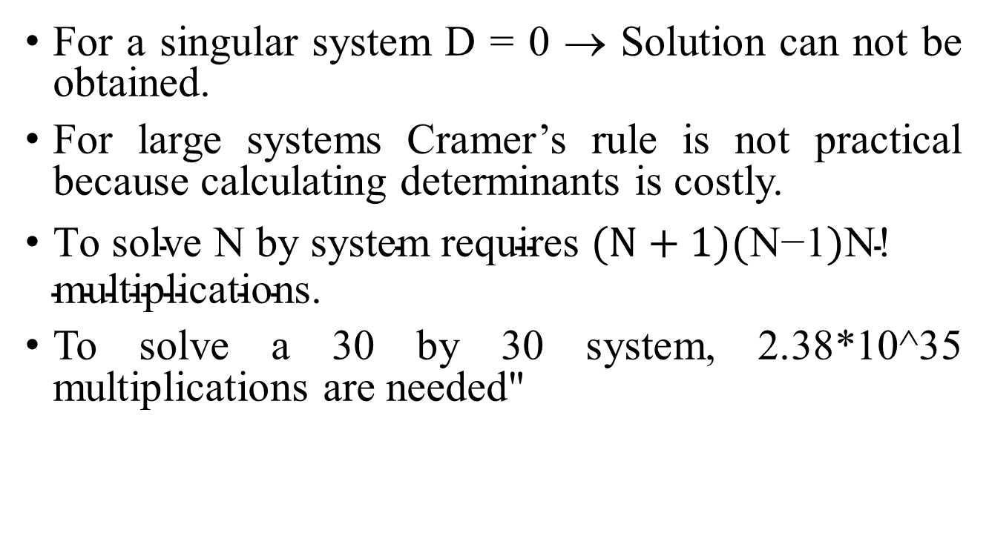
2. Cramer’s Rule
For a singular system D = 0 → Solution can not be obtained.
For large systems Cramer’s rule is not practical because calculating determinants is costly.
$\text{To} \text{solve} \text{N} \text{by} \text{system} \text{requires} (N+1)(\text{N}\text{−}\text{1})\text{N}\text{! }\text{multiplications}\text{.}$
To solve a 30 by 30 system, 2.38*10^35 multiplications are needed"

Slide 15
3. Method of Elimination
The basic strategy is to successively solve one of the equations of the set for one of the unknowns and to eliminate that variable from the remaining equations by substitution.
The elimination of unknowns can be extended to systems with more than two or three equations. However, the method becomes extremely tedious to solve by hand.

Slide 16
3. Elimination of Unknowns Method
2.5x₁ + 6.2x₂ = 3.0
4.8x₁ - 8.6x₂ = 5.5
Given a 2x2 set of equations:
Multiply the 1st eqn by 8.6
and the 2nd eqn by 6.2 ➔
21.50x₁ + 53.32x₂=25.8
29.76x₁ – 53.32x₂=34.1
Add these equations ➔ 51.26 x₁ + 0 x₂ = 59.9
Solve for x₁ : x₁ = 59.9/51.26 = 1.168552478
Using the 1st eqn solve for x₂ :
x₂ =(3.0–2.5*1.168552478)/6.2 = 0.01268045242
Check if these satisfy the 2nd eqn:
4.8*1.168552478–8.6*0.01268045242 = 5.500000004
(Difference is due to the round-off errors).

Slide 17
4. Naïve Gauss Elimination
For larger systems, Cramer’s Rule or Elimination method can become unwieldy.
Instead, a sequential process of removing unknowns from equations using forward elimination followed by back substitution may be used - this is Gauss elimination.
“Naïve” Gauss elimination simply means the process does not check for potential problems resulting from division by zero.

Slide 18
4. Naive Gauss Elimination Method
Consider the following system of n equations.
a₁₁x₁ + a₁₂x₂ + ... + a_{1n}x_{n} = b₁ (1)
a₂₁x₁ + a₂₂x₂ + ... + a_{2n}x_{n} = b₂ (2)
...
a_{n1}x₁ + a_{n2}x₂ + ... + a_{nn}x_{n} = b_{n} (n)
Form the augmented matrix of [A|B].
Step 1 : Forward Elimination: Reduce the system to an upper triangular system.
1.1- First eliminate x₁ from 2nd to n^{th} equations.
- Multiply the 1st eqn. by a₂₁/a₁₁ & subtract it from the 2nd equation.
This is the new 2nd eqn.
- Multiply the 1st eqn. by a₃₁/a₁₁ & subtract it from the 3rd equation.
This is the new 3rd eqn.
...
- Multiply the 1st eqn. by a_{n1}/a₁₁ & subtract it from the n^{th} equation.
This is the new n^{th} eqn.

Slide 19
4. Naive Gauss Elimination Method
Note:
In these steps the 1st eqn is the pivot equation and a₁₁ is the pivot element.
Note that a division by zero may occur if the pivot element is zero. Naive-Gauss Elimination does not check for this.
The modified system is ➔
indicates that the
system is modified once.

Slide 20
4. Naive Gauss Elimination Method (cont’d)
1.2- Now eliminate x₂ from 3rd to n^{th} equations.
The modified system is ➔
Repeat steps (1.1) and (1.2) upto (1.n-1).
we will get this upper triangular system ➔

Slide 21
4. Naive Gauss Elimination Method (cont’d)
Step 2 : Back substitution
Find the unknowns starting from the last equation.
1. Last equation involves only x_{n}. Solve for it.
2. Use this x_{n} in the (n-1)th equation and solve for x_{n-1}.
...
3. Use all previously calculated x values in the 1st eqn and solve for x₁.

Slide 22
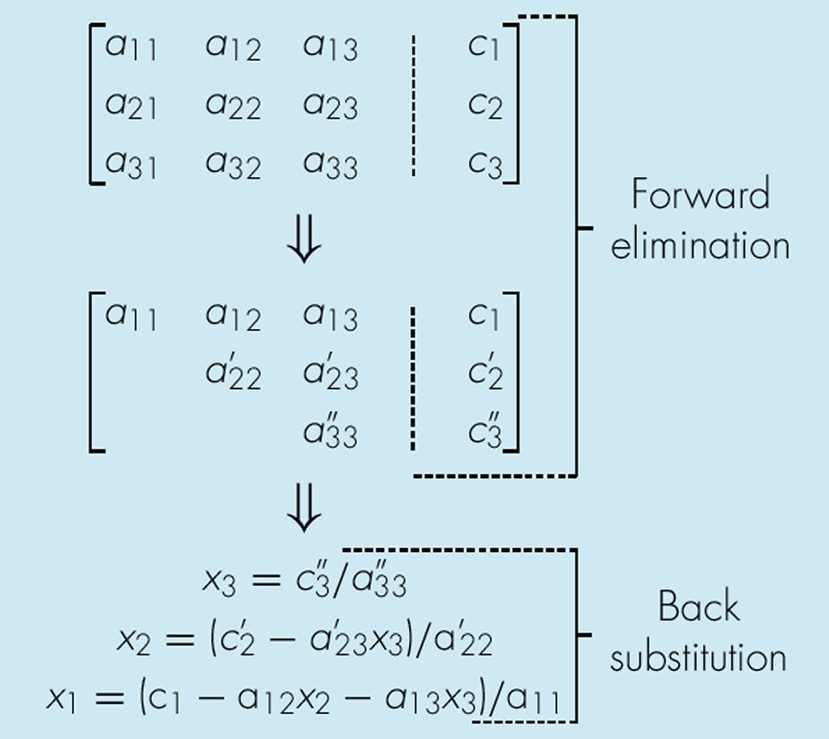
Summary of Naive Gauss Elimination Method

Slide 23
Naive Gauss Elimination Method
Example 1
Solve the following system using Naive Gauss Elimination.
6x₁ – 2x₂ + 2x₃ + 4x₄ = 16
12x₁ – 8x₂ + 6x₃ + 10x₄ = 26
3x₁ – 13x₂ + 9x₃ + 3x₄ = -19
-6x₁ + 4x₂ + x₃ - 18x₄ = -34
Step 0: Form the augmented matrix
6 –2 2 4 | 16
12 –8 6 10 | 26 R2-2R1
3 –13 9 3 | -19 R3-0.5R1
-6 4 1 -18 | -34 R4-(-R1)

Slide 24
Naive Gauss Elimination Method
Example 1 (cont’d)
Step 1: Forward elimination
1. Eliminate x₁ 6 –2 2 4 | 16 (Does not change. Pivot is 6)
0 –4 2 2 | -6
0 –12 8 1 | -27 R3-3R2
0 2 3 -14 | -18 R4-(-0.5R2)
2. Eliminate x₂ 6 –2 2 4 | 16 (Does not change.)
0 –4 2 2 | -6 (Does not change. Pivot is-4)
0 0 2 -5 | -9
0 0 4 -13 | -21 R4-2R3
3. Eliminate x₃ 6 –2 2 4 | 16 (Does not change.)
0 –4 2 2 | -6 (Does not change.)
0 0 2 -5 | -9 (Does not change. Pivot is 2)
0 0 0 -3 | -3

Slide 25
Naive Gauss Elimination Method Example 1 (cont’d)
Step 2: Back substitution
Find x₄ x₄ =(-3)/(-3) = 1
Find x₃ x₃ =(-9+5*1)/2 = -2
Find x₂ x₂ =(-6-2*(-2)-2*1)/(-4) = 1
Find x₁ x₁ =(16+2*1-2*(-2)-4*1)/6 = 3

Slide 26
Naive Gauss Elimination Method Example 2 (Using 6 Significant Figures)
3.0 x₁ - 0.1 x₂ - 0.2 x₃ = 7.85
0.1 x₁ + 7.0 x₂ - 0.3 x₃ = -19.3 R2-(0.1/3)R1
0.3 x₁ - 0.2 x₂ + 10.0 x₃ = 71.4 R3-(0.3/3)R1
Step 1: Forward elimination
3.00000 x₁- 0.100000 x₂ - 0.200000 x₃ = 7.85000
7.00333 x₂ - 0.293333 x₃ = -19.5617
- 0.190000 x₂ + 10.0200 x₃ = 70.6150
3.00000 x₁- 0.100000 x₂ - 0.20000 x₃ = 7.85000
7.00333 x₂ - 0.293333 x₃ = -19.5617
10.0120 x₃ = 70.0843

Slide 27
Naive Gauss Elimination Method Example 2 (cont’d)
Step 2: Back substitution
x₃ = 7.00003
x₂ = -2.50000
x₁ = 3.00000
Exact solution:
x₃ = 7.0
x₂ = -2.5
x₁ = 3.0

Slide 28
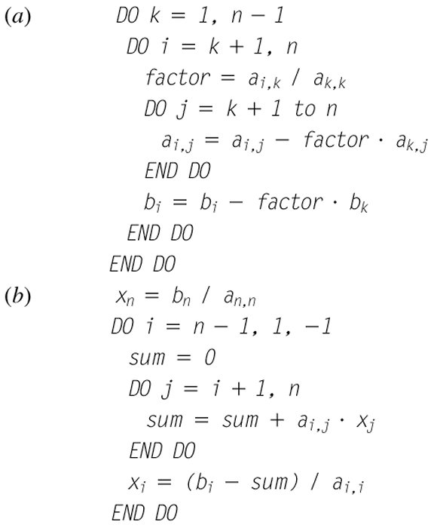
Pseudo-code of Naive Gauss Elimination Method
(a) Forward Elimination (b) Back substitution
k,j

Slide 29
function x = GaussNaive(A,b)
% GaussNaive: naive Gauss elimination
% x = GaussNaive(A,b): Gauss elimination without pivoting.
% input:
% A = coefficient matrix
% b = right hand side vector
% output:
% x = solution vector
[m,n] = size(A);
if m~=n
error('Matrix A must be square');
end
nb = n+1;
Aug = [A b];
% forward elimination
for k = 1:n-1
for i = k+1:n
factor = Aug(i,k)/Aug(k,k);
Aug(i,k:nb) = Aug(i,k:nb)-factor*Aug(k,k:nb);
end
end
% back substitution
x = zeros(n,1);
x(n) = Aug(n,nb)/Aug(n,n);
for i = n-1:-1:1
x(i) = (Aug(i,nb)-Aug(i,i+1:n)*x(i+1:n))/Aug(i,i);
end
end

